Slide 1

Chinese K12 Education WeChat Article
Search Engine
CS410 Final Project
Gelei Chen
geleic2@Illinois.edu

Slide 2
Contents
Live Demo
Installation
Usage Instruction

Slide 3
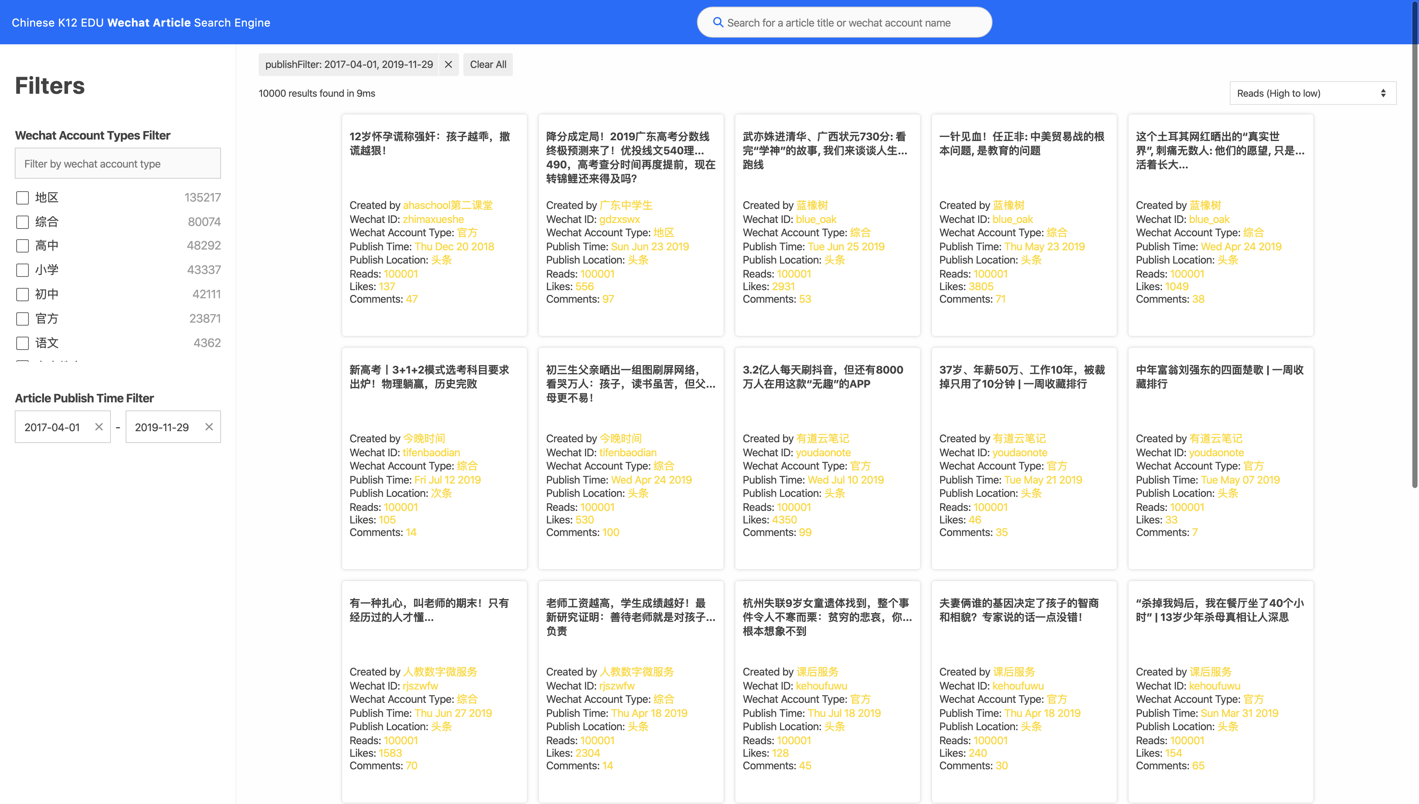


1.Live Demo
http://3.14.12.231:8002/
7. Search by the keyword
6. Filters/Clear all filters
1.Filter by WeChat account type
5. Engine statistics
4. Sort by Reads/Publish time
2. Filter by article publish time
3. The searched/filtered/ranked results

Slide 4
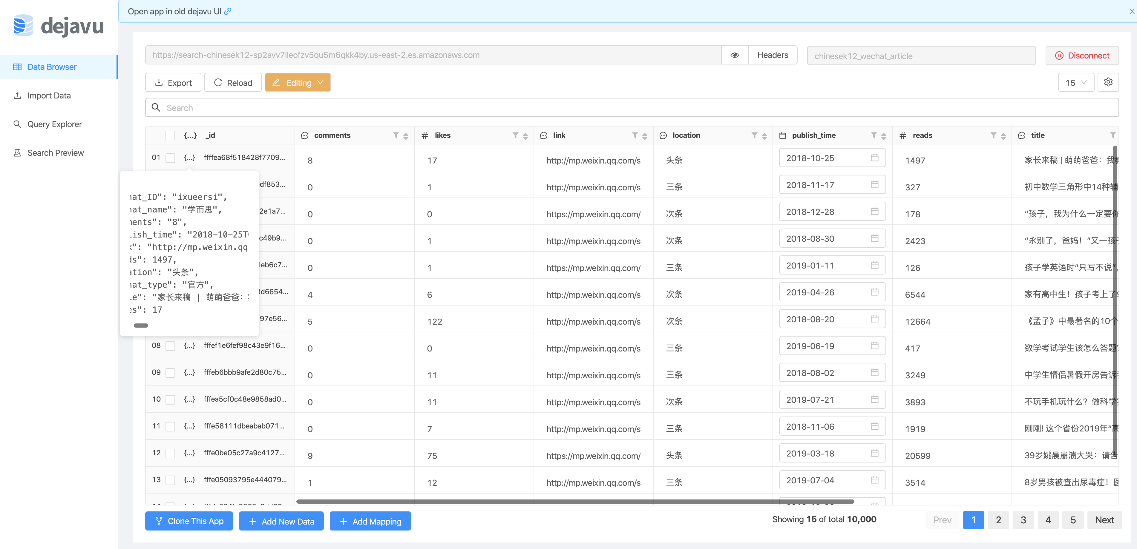
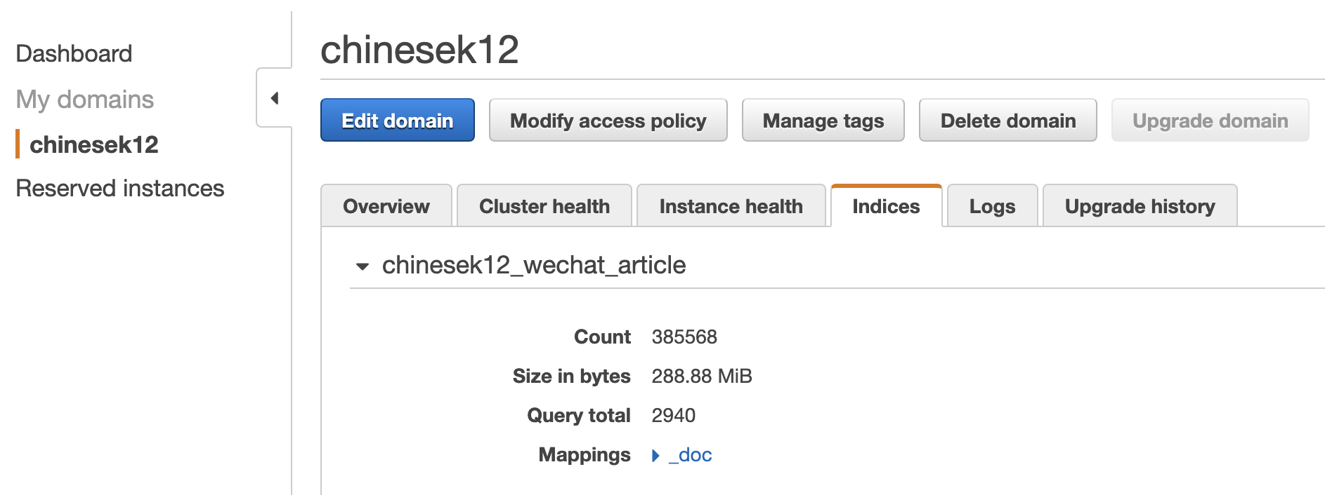
1.Live Demo
http://3.14.12.231:8002/
Server-side
385568

Slide 5
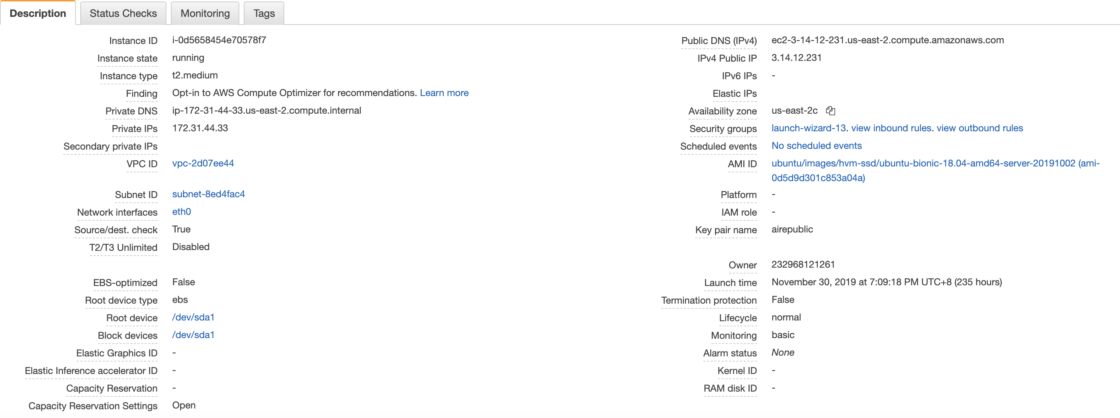
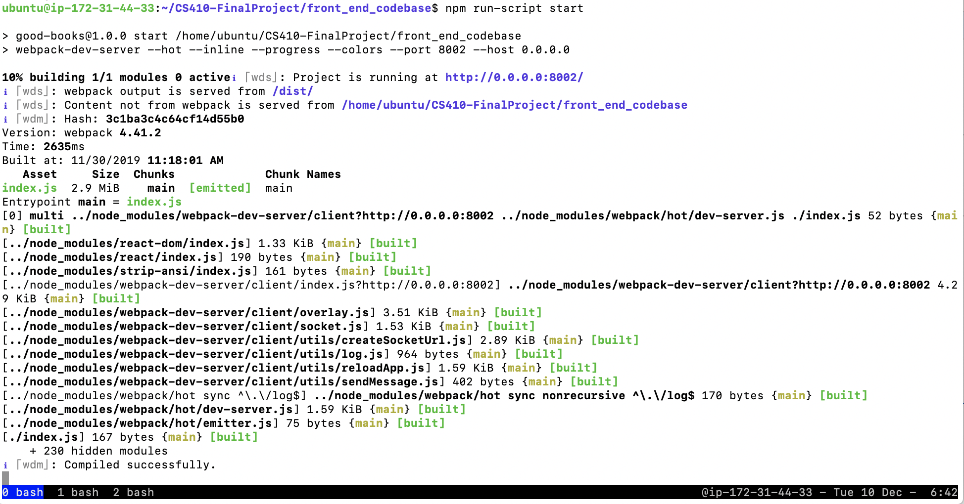
1.Live Demo
http://3.14.12.231:8002/
Client-side

Slide 6
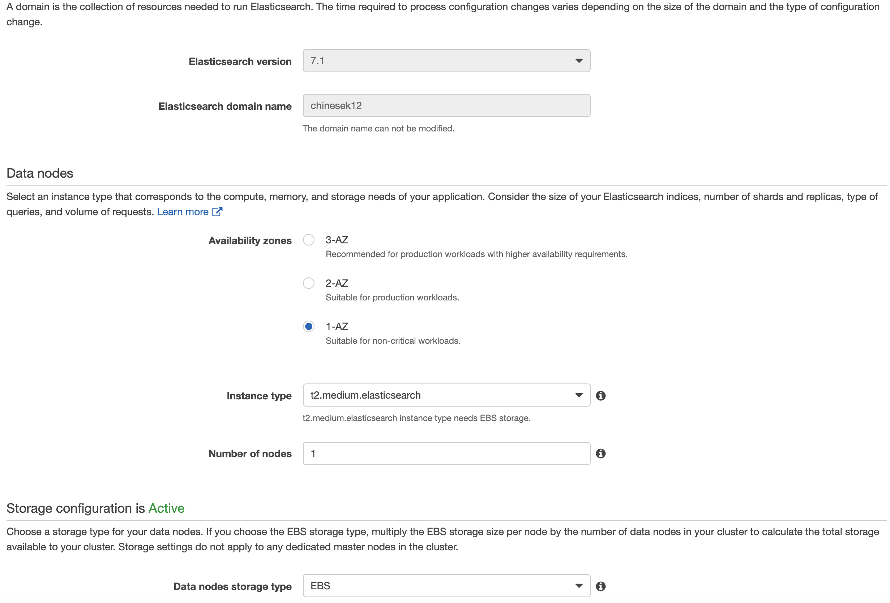
2.Installation
Server-side: Setup AWS Elasticsearch service & Write data into it
https://aws.amazon.com/elasticsearch-service/
geleichen@Gelei-2: ~/Desktop/UIUC/final_project/CS410-FinalProject/k12_wechat_article_downloading master ⚡ $ python upload_csv_to_elasticsearch.py [14:48:30]

Slide 7
2.Installation
Client-side: Setup AWS EC2 & Install dependence & Host the application
ssh into the client machine
git clone https://lab.textdata.org/geleic2/Course_Project.git
cd Course_Project/front_end_codebase
npm install
npm run-script start
Navigate to http://localhost:8002

Slide 8
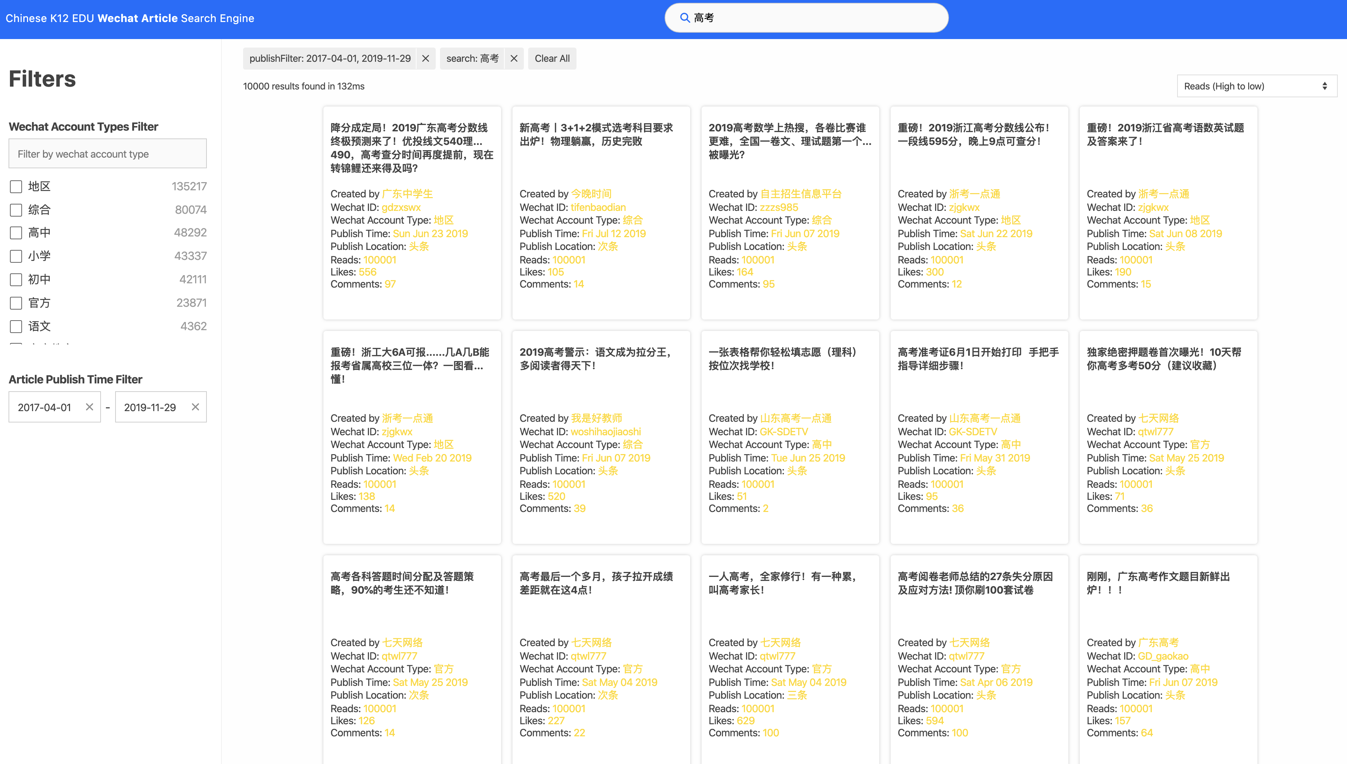
3. Usage Instruction
Case 1: K12 Education social media Editors
As an

Slide 9
3. Usage Instruction
Case 2: K12 Education investors

Slide 10
Thank you

